Slide 1
Software Engineering
Intermediate Report

Slide 2
1. About our Application
2. Scrum
3. SRS
4. Analysis Model
I n d e x

Slide 3
About our application
1

Slide 4
HYUⓔmini
Objective
“Simplicity is the ultimate sophistication.”
Leonardo da Vinci
Notes:
HYUⓔmini Project는 기존의 한양대학교 애플리케이션에서 학생들에게 자주 이용되는 필수적인 기능만을 추출하여 좀 더 사용하기 편하게 리팩토링하여 서비스를 제공하기 위해 시작되었습니다.

Slide 5
HYUⓔmini
Target User
Original
HYUⓔmini
Seoul Campus Professor Academy
Employee
… Too Complex!
ERICA Student ONLY!
Notes:
기존의 한양대학교 애플리케이션은 서울캠퍼스, ERICA캠퍼스의 모든 학부생, 교직원, 사무원, 대학원생이 사용했다면,
저희 애플리케이션은 오로지 ERICA 캠퍼스의 학부생만을 타겟으로하여 더 쉽게, 더 간편하게 필요한 기능에 접근하게끔 만들었습니다.

Slide 6


HYUⓔmini
Target Platform

Slide 7
HYUⓔmini
Stakeholder
Prof. Scott Lee
Manager (School)
Ten Developers
ERICA Students

Slide 8
Scrum
2

Slide 9
Why?
Why are we select Scrum?
Speed up development
Can introduce XP partially.
Notes:
이터레이션 중에 요구사항 변경이 없음.
효율적인 분업
빠른 개발
주기적인 요구사항 리뉴얼

Slide 10
How?
How can we apply Scrum to our project?
Free Member Switching
Apply XP Methodology
Daily Scrum Meeting

Slide 11
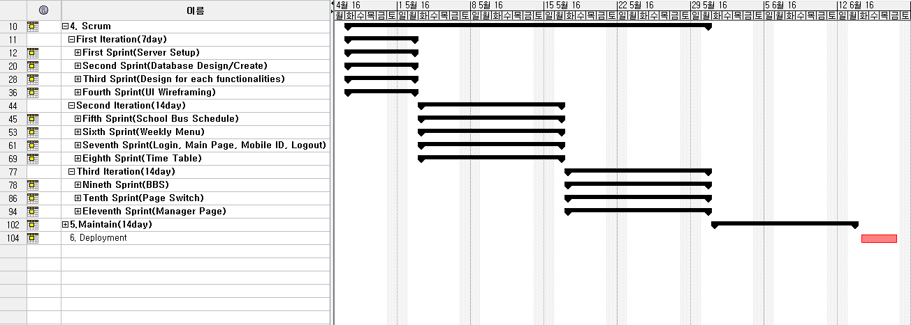
Scrum planning
Gantt Chart

Slide 12
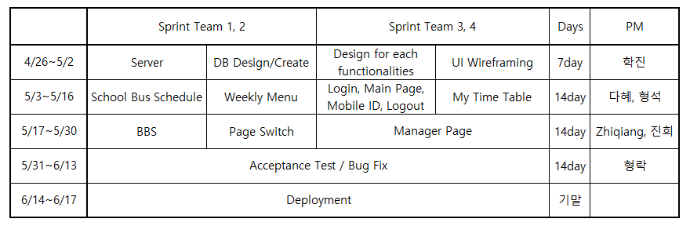
Scrum planning
Scrum Chart

Slide 13
SRS
3

Slide 14
SRS Format
Introduction
Purpose
Scope of Project
Glossary
Overview of Document

Slide 15
SRS Format
Overall Description
System Environment
User Characteristics
Use Cases
Use Case 1: Login System
Description
Use Case Diagram
Use Case 2: Main Page
…

Slide 16
SRS Format
Requirements Specification
Use Case1: Login System
Functional Requirement1: …
Functional Requirement2: …
…
Non-functional Requirement5: …
…
Use Case2: Main Page
Functional Requirement1: …
…
…
Non Functional Requirements
non-functional requirements 1
non-functional requirements 2
…

Slide 17
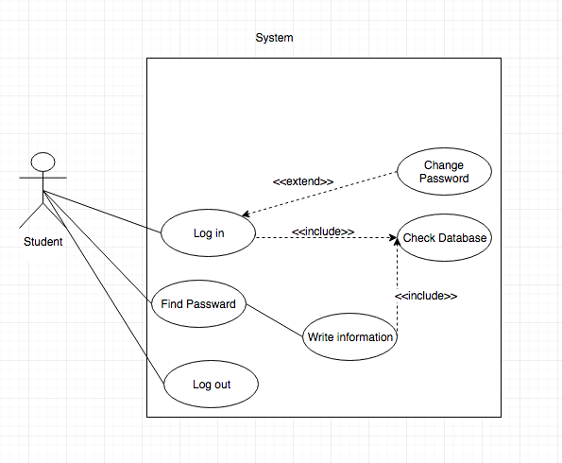
Use Case 1. Login/Logout
Use Case 1. Login/Logout

Slide 18
Use Case 1. Login/Logout
Description(User Scenario)
Want to check information -> 1. Find Password 2. Input ID, Password -> Change password
Functional Requirement
Log-in, Log-out, Find Password, Change Password
Non-Functional Requirement
Easy to know, Simple

Slide 19
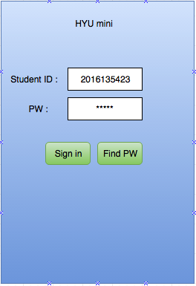
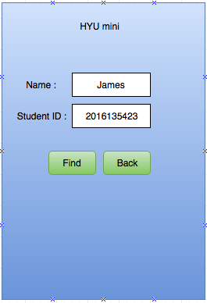
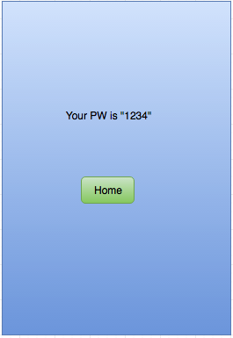
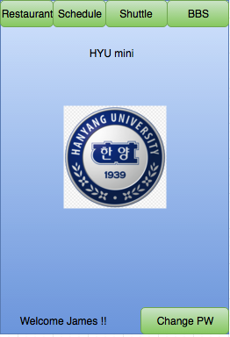
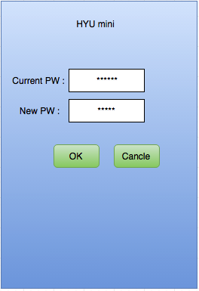
Use Case 1. Login/Logout

Slide 20
Use Case 2. Main Page
Use Case Diagram

Slide 21
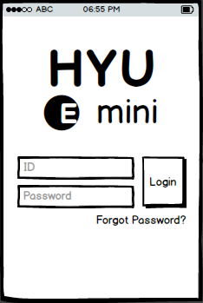
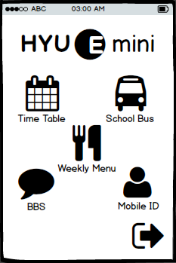
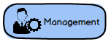
Use Case 2. Main Page
Description(User Scenario)
Login
Succeed
Manager Login
Login Page
Main Page

Slide 22



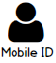
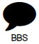

Use Case 2. Main Page
Requirements
Logout

Slide 23
Use Case 3. BBS

Slide 24

Use Case 3. BBS
Student or Master logins the application

Slide 25
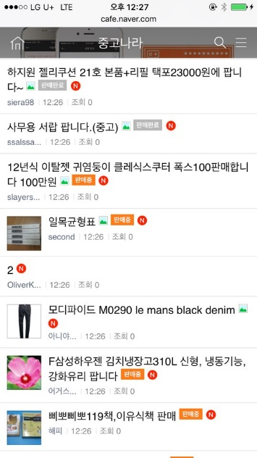

Use Case 3. BBS
1/3. In the List Page (BBS main page)
Pre-con. Student accesses into a bulletin board page

Slide 26



Use Case 3. BBS
1/3. In the List Page (BBS main page)
The list page added content written
Write
Writing Contents
Pre-con. Student accesses into a bulletin board page
The list page of the searching result
input
Searching Contents
The content page
Title
Reading Contents

Slide 27
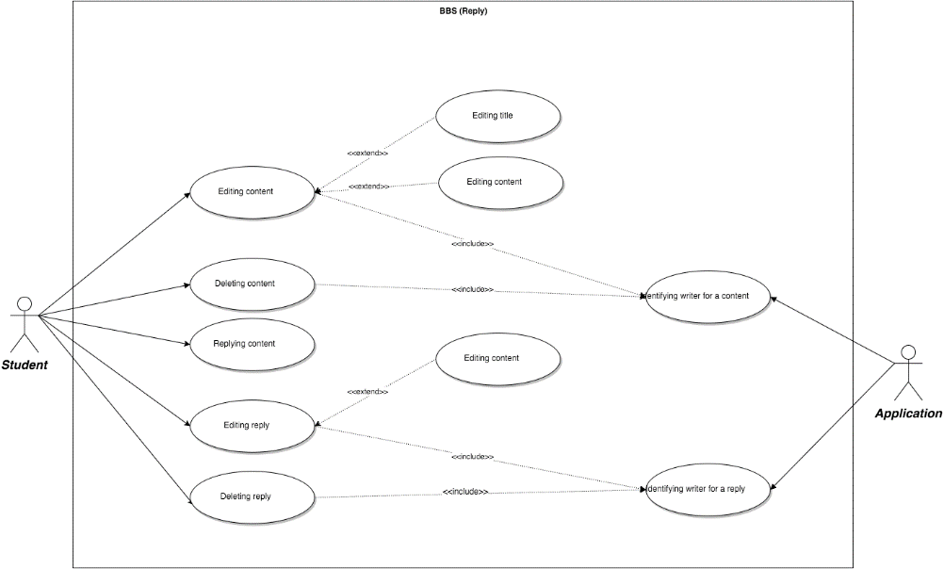
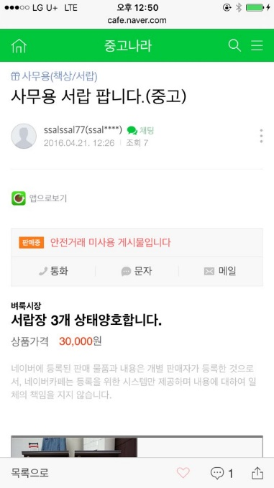


Use Case 3. BBS
2/3. In the Content Page
Pre-con. Student accesses into the content page
Pre-con. Student wrote the content before

Slide 28




Use Case 3. BBS
2/3. In the Content Page
The content page updating edited content or reply
Pre-con. Student accesses into the content page
Editing
Deleting Contents
Edit
The content page updating deleted content or reply
Delete
Pre-con. Student wrote the content before
The content page
Reading Writing
Editing Deleting Reply
Title
Write
The content page added reply
Edit
Delete

Slide 29

Use Case 3. BBS
3/3. As a Master (in the content page)
Deleting Contents
Delete
Pre-con. Master don’t need to pre-con. in constraint to student
The content page updating deleted content or reply
Deleting Reply
Delete

Slide 30
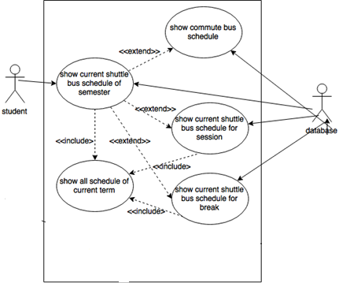
Use Case 4. Bus Schedule

Slide 31
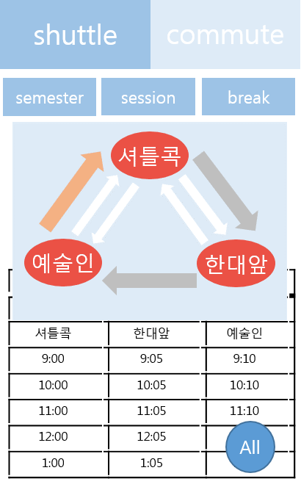
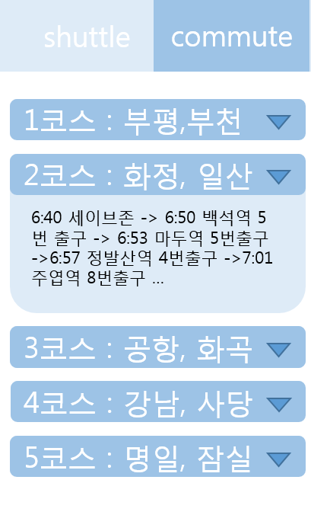

Slide 32
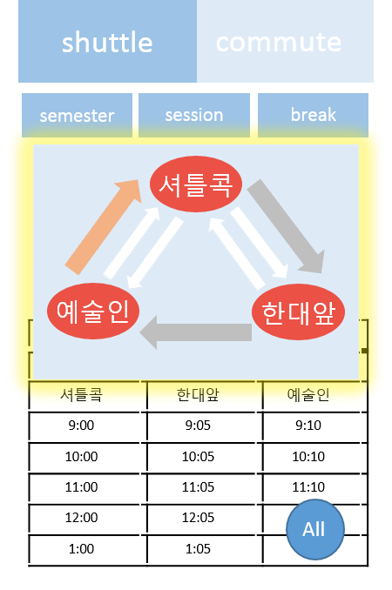
Use Case 4. Bus Schedule
Show current shuttle bus schedule
Precondition | Run 'HYUⓔmini' application
Basic Path | 1. User can see two tabs(Shuttle bus and Commute bus). And default is shuttle bus tab. 2. ’Shuttle Bus Schedule’ shows shuttle bus schedule in graphical format.(Bus on operating is showed with tracking the current location of the bus)
Alternative Paths | In step 1, It ‘Commute bus schedule’ tab is clicked, User can see the commute bus schedule. In step 2, If ‘Entire shuttle schedule’ is clicked, User can see whole shuttle bus schedule.
Postcondition | Shuttle bus schedule is provided in visualized format

Slide 33
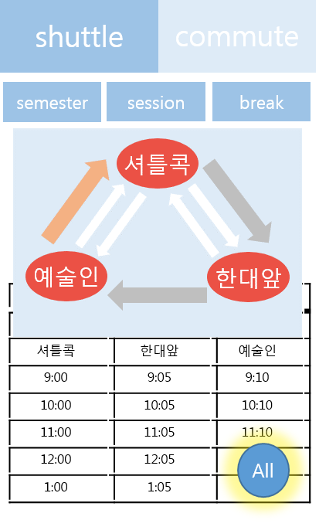
Use Case 4. Bus Schedule
Show entire shuttle bus schedule
Precondition | User checked shuttle bus schedule
Basic Path | 1. User clicks ‘Entire shuttle schedule’ button to check entire shuttle bus schedule.
Alternative Paths
Post Condition | Entire ‘Semester’ shuttle bus schedule is provided in visualized format

Slide 34
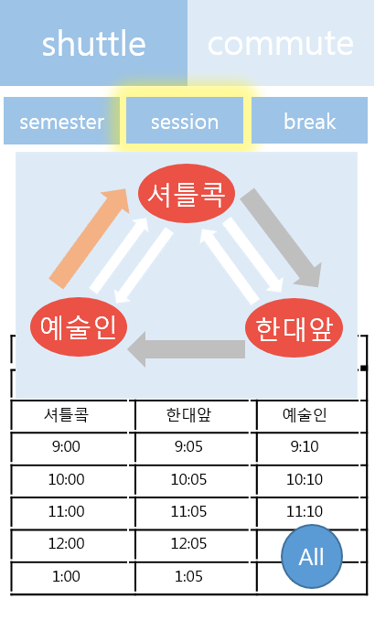
Use Case 4. Bus Schedule
Show entire shuttle bus schedule for session
Precondition | User checked semester or break shuttle bus schedule
Basic Path | 1. User can see shuttle bus schedule of session term
Alternative Paths
Post Condition | Entire ‘Session’ shuttle bus schedule is provided in visualized format

Slide 35
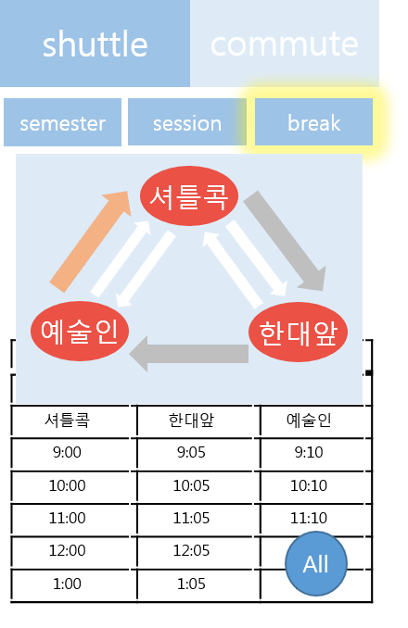
Use Case 4. Bus Schedule
Show entire shuttle bus schedule for break
Precondition | User checked semester or session shuttle bus schedule
Basic Path | 1. User can see shuttle bus schedule of break term
Alternative Paths
Post Condition | Entire ‘Break’ shuttle bus schedule is provided in visualized format

Slide 36
Use Case 4. Bus Schedule
Show commute bus schedule
Precondition | User checked shuttle bus schedule
Basic Path | 1. User clicks commute bus schedule tab to check commute bus schedule. 2. In commute bus schedule tab, user can select which route to be displayed among 9 routes. 3. Application displays selected route.
Alternative Paths
Postcondition | Commute bus schedule is provided in visualized format

Slide 37
Use Case 5. Time Table
Description for Time Table
Lecture Schedule is for student who want to see lecture schedule in 'HYUⓔmini'. In addition to basic function of showing lecture schedules, 'HYUⓔmini' also provides highlight view mode of making highlight to current schedule, adding personal schedule function that user can add their personal schedule and sharing function that user can share their schedule through ‘Kakao Talk’. Also user can save their schedule in their local machine

Slide 38
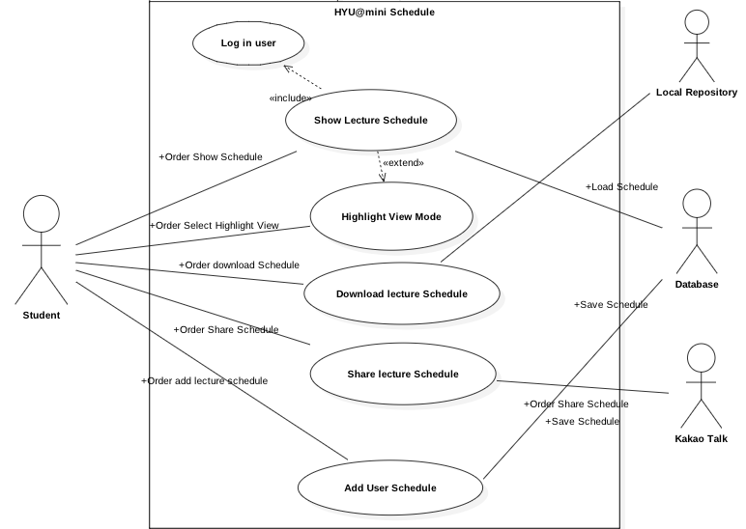
Use Case 5. Time Table
Use Case Diagram

Slide 39
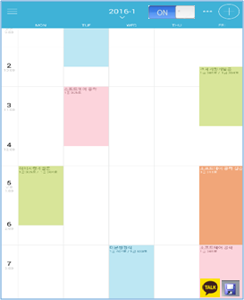

Use Case 5. Time Table
Show Lecture Schedule

Slide 40
Use Case 5. Time Table
Download Schedule

Slide 41
Use Case 5. Time Table
Share Schedule

Slide 42
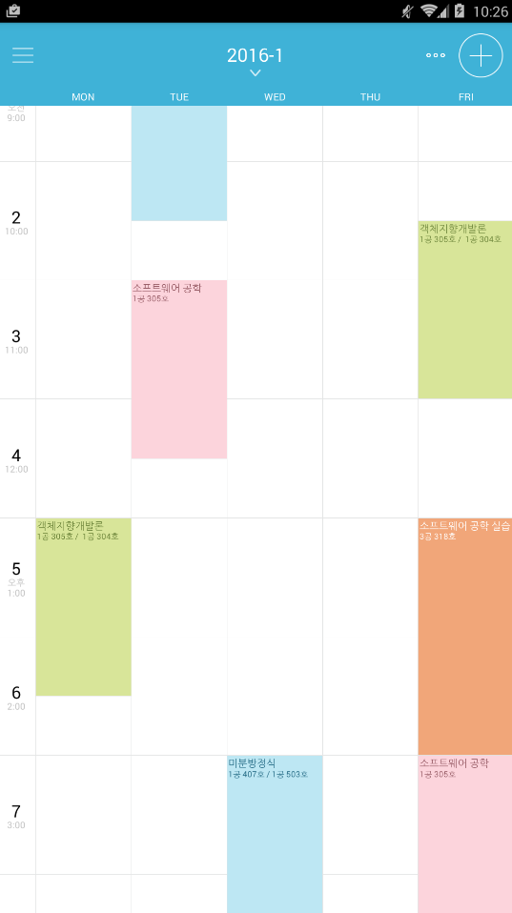

Use Case 5. Time Table
Highlight View
다음 일정 입니다
10:30 AM

Slide 43
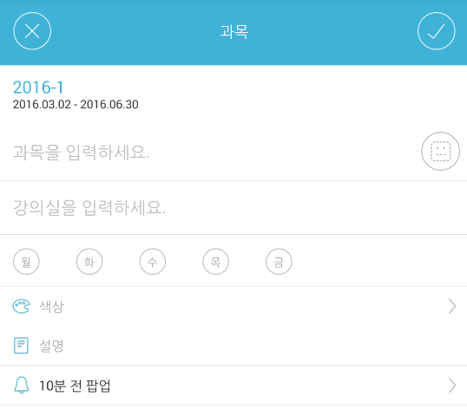

Use Case 5. Time Table
Add User Schedule
일 정
일정을 입력하세요
시간을 입력하세요

Slide 44


Use Case 5. Time Table
Non-Functional
If “Kakoa Talk” didn’t installed in local machine and mobile phone, user can’t access the Share lecture Schedule function in “HYUⓔmini”
The system should protect itself and its sensitive data from unauthorized access, malicious, modification. If there is no reaction, the user will be log-out automatically

Slide 45
Use Case 6. Weekly Menu
Use Case Diagram

Slide 46
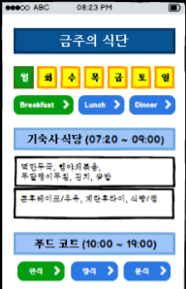
Use Case 6. Weekly Menu
Description(User Scenario)
Button
Pressed

Slide 47
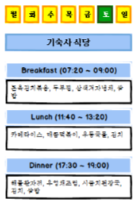
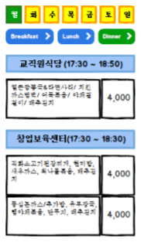
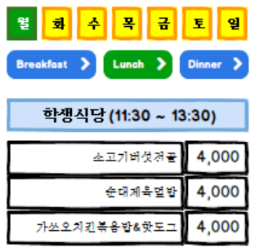
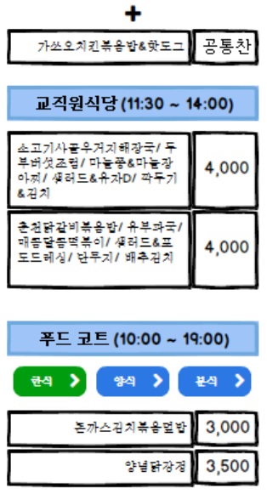
Use Case 6. Weekly Menu
Requirements

Slide 48
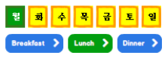
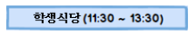
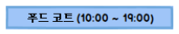
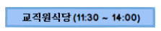
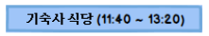
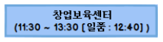
Use Case 6. Weekly Menu
Description(User Scenario)
Dragging

Slide 49
Use Case 7. Manager Page
Our own database
Maliciious modifying

Slide 50
Use Case 7. Manager Page
Functional Requirement
- Student information
- Bus schedule
- Lecture

Slide 51
Use Case 7. Manager Page
Student information
- Add new student
- Modify student information
- Delete student

Slide 52
Use Case 7. Manager Page
Bus schedule
- Update(modify) bus schedule

Slide 53
Use Case 7. Manager Page
Lecture
- Add lecture
- Modify lecture information
- Delete lecture

Slide 54
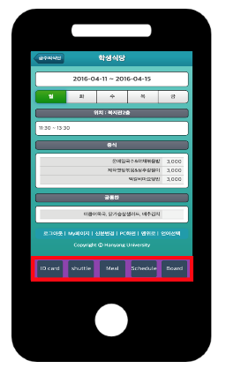

Use Case 8. Page Switch

Slide 55
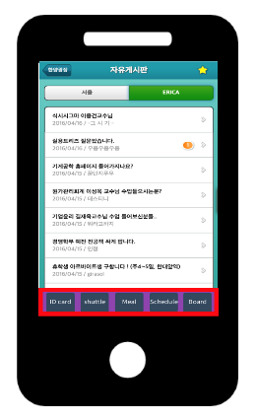
Use Case 8. Page Switch
Intuitive One Click
Access All Category Successfully

Slide 56
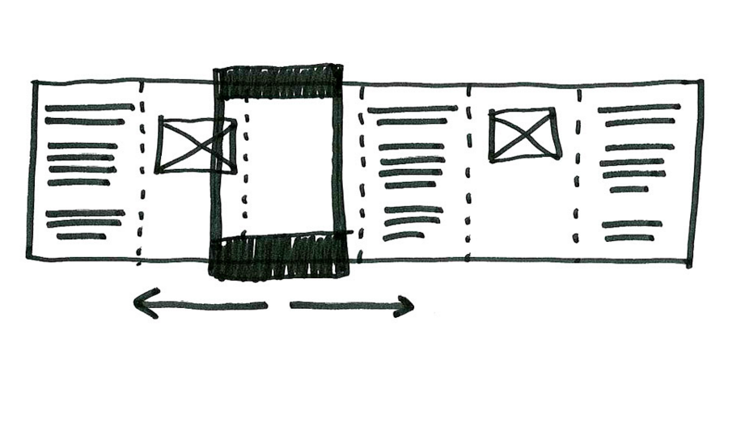
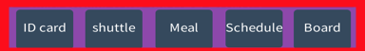
Use Case 8. Page Switch
Intuitive One Click
Access All Category Successfully

Slide 57
Analysis Model
4

Slide 58
Which?
Which diagrams are selected?
Use Case Diagram
Activity Diagram

Slide 59
Why?
Why are we select these diagrams?
Because…
HYUⓔmini is Activity-Oriented Application.

Slide 60
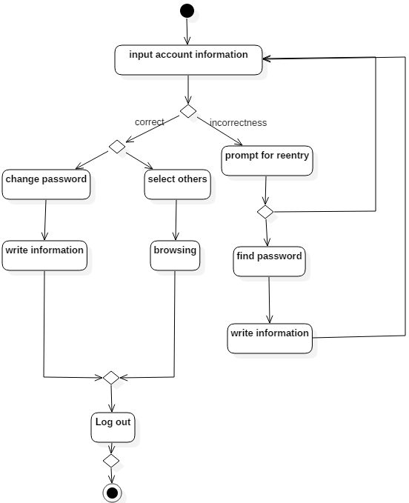
Use Case 1. Login/Logout
Activity Diagram
Log in
Log out
Find password
Change password

Slide 61
Use Case 1. Login/Logout
Sign up
In this application, we don't need it.
Find password
for students who forget their password
Change password
for student who did not change password for long time

Slide 62
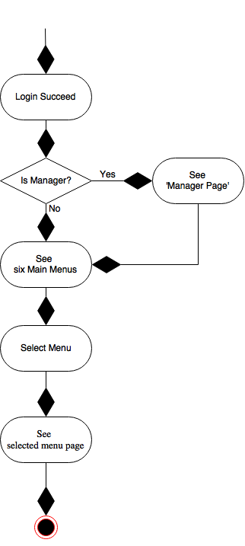
Use Case 2. Main Page

Slide 63
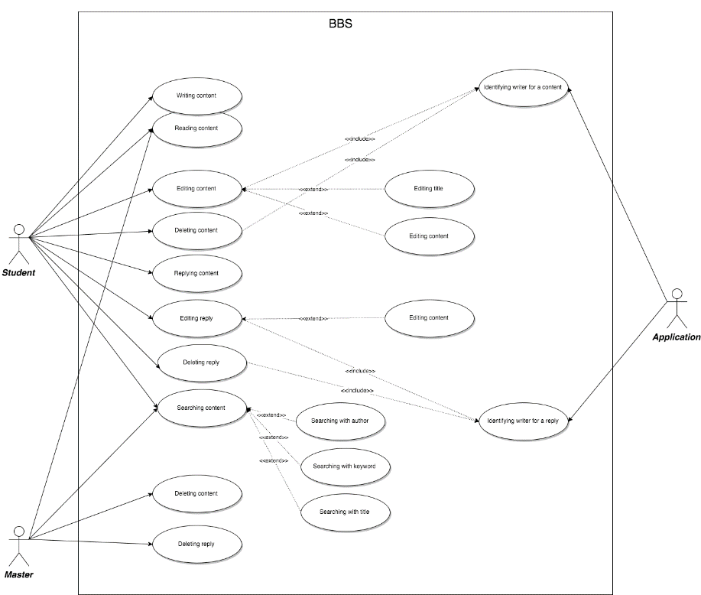
Use Case 3. BBS

Slide 64
Use Case 4. Bus Schedule
Use Case Diagram

Slide 65
Use Case 4. Bus Schedule
Activity Diagram

Slide 66
Use Case 5. Time Table
Use Case Diagram

Slide 67
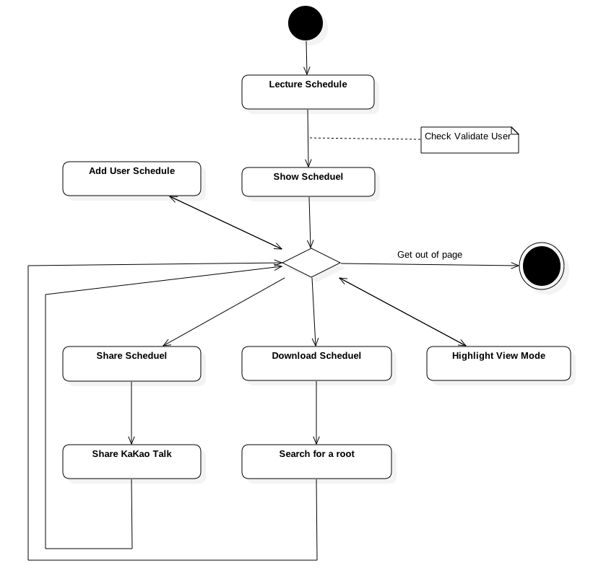
Use Case 5. Time Table
Activity Diagram
Show - Show the Lecture Schedule
Download - Download to storage
Share - Share Schedule to friends
Highlight - Highlight the near by schedule
Add - Add schedule not only lecture

Slide 68
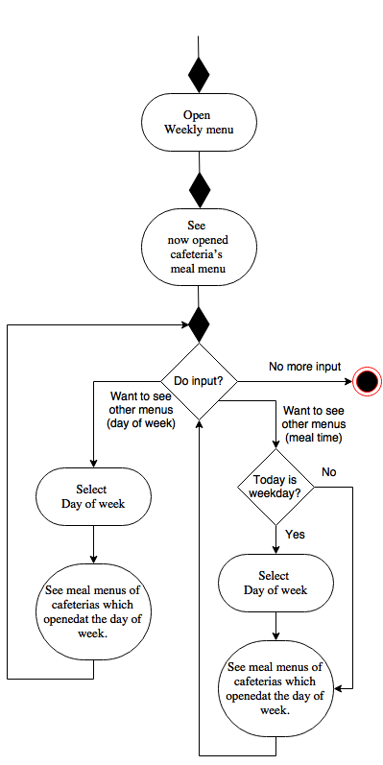
Use Case 6. Weekly Menu

Slide 69
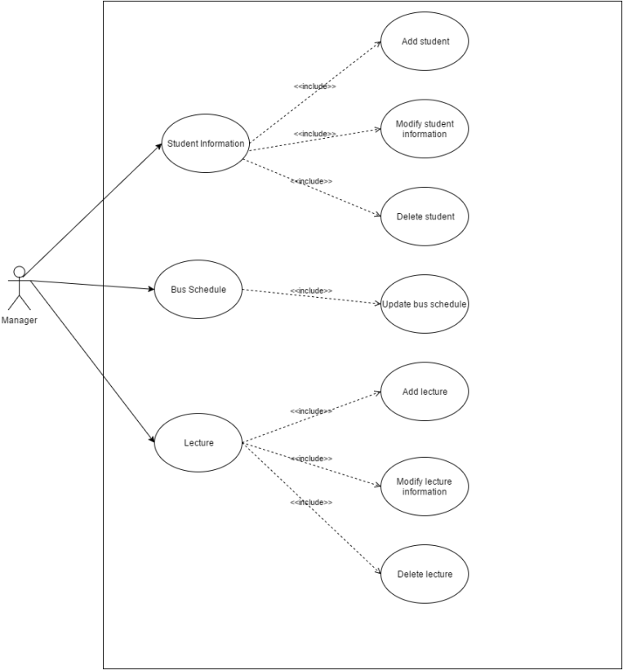
Use Case7. Manager Page
Use Case Diagram

Slide 70
Use Case7. Manager Page
Activity Diagram

Slide 71
Use Case 8. Page Switch

Slide 72
Use Case 8. Page Switch
Intuitive One Click
Access All Category Successfully

Slide 73
Use Case 8. Page Switch
Intuitive One Click
Access All Category Successfully

Slide 74
Fin.

